Slide 1
HTML, WebElements,
& DOM Relationship
Trainer: Rex Jones II

Slide 2

Lesson Plan
Relationship Between HTML, WebElements, & DOM
Use Selenium Locators To Find WebElements
Create Customized XPath Values For Selenium
Create Customized CSS Selector Values For Selenium

Slide 3
Lesson Plan
Relationship Between HTML, WebElements, & DOM
Use Selenium Locators To Find WebElements
Create Customized XPath Values For Selenium
Create Customized CSS Selector Values For Selenium

Slide 4
HTML

Slide 5
WebElements

Slide 6
Document Object
Model (DOM)

Slide 7
Document Object Model (DOM)
Identify How To Access An HTML Document
Identify How To Manipulate An HTML Document
Identify The Logical Format Of An HTML Document

Slide 8
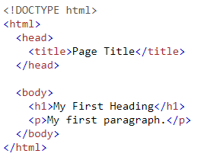
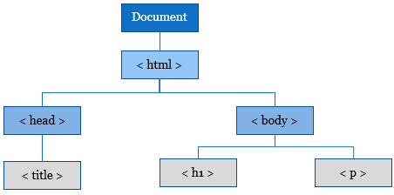
Document Object Model (DOM)
HTML Document
DOM Hierarchy

Slide 9
Lesson Plan
Relationship Between HTML, WebElements, & DOM
Use Selenium Locators To Find WebElements
Create Customized XPath Values For Selenium
Create Customized CSS Selector Values For Selenium

